Slide 1

CREDIT RISK Data(Python LOGISTIC Regression Model)
A Project by Debasmita Paul

Slide 2
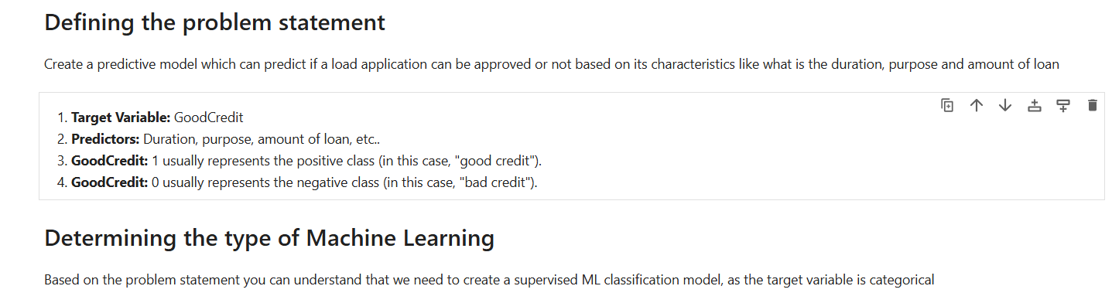
Defining The Problem And Determining The ML Approach
The goal is to create a supervised machine learning classification model that predicts whether a loan application will be approved based on features like duration, purpose, and loan amount, with the target variable "GoodCredit" representing good (1) or bad (0) credit risk. This model facilitates accurate risk assessment and informed decision-making for loan approvals.

Slide 3
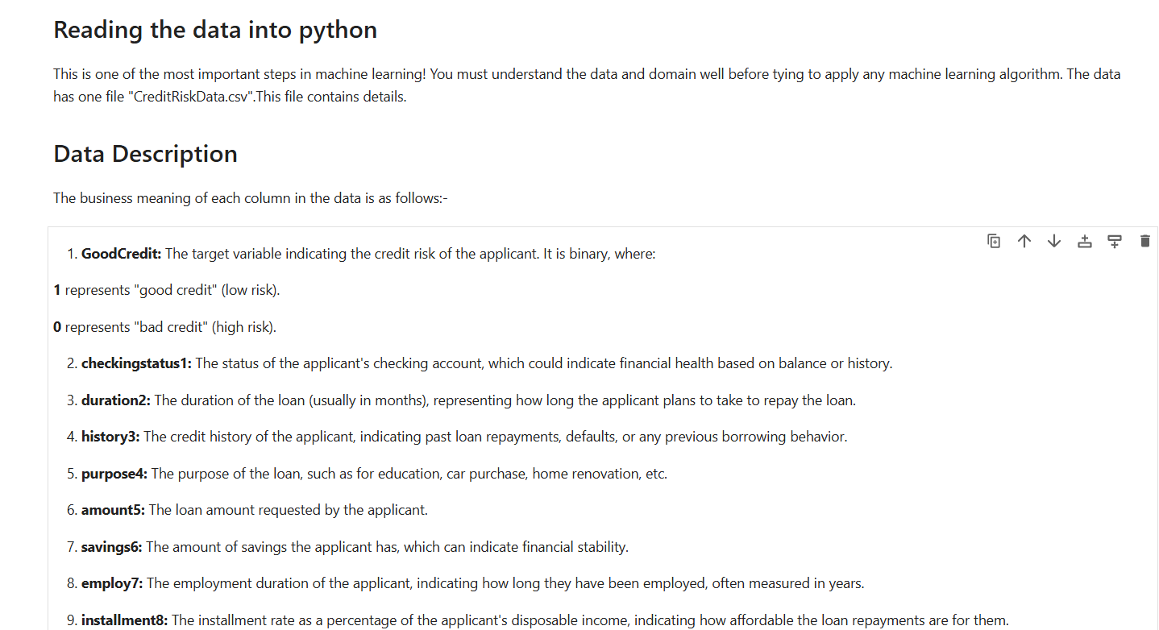
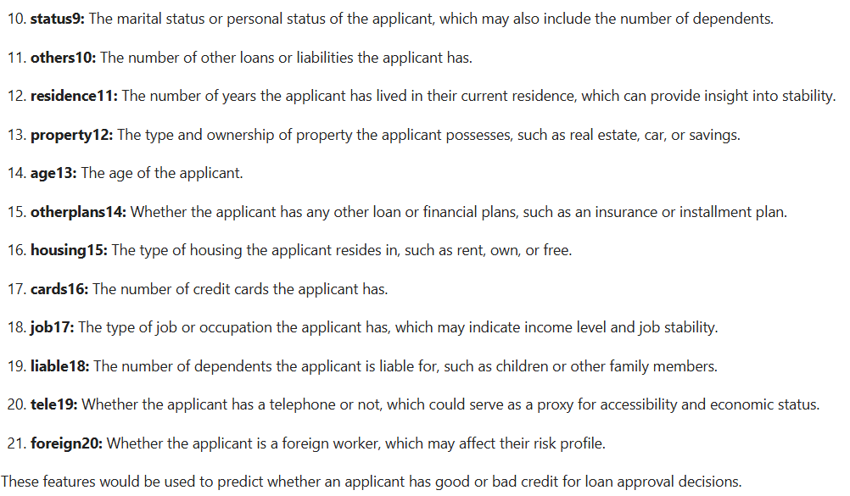
Data Overview And Understanding
The dataset contains details about loan applicants, including characteristics like checking account status, loan duration, credit history, loan amount, and other financial indicators, to predict whether an applicant will have good (1) or bad (0) credit risk. These features will be used to develop a supervised machine learning classification model for loan approval decisions.

Slide 4
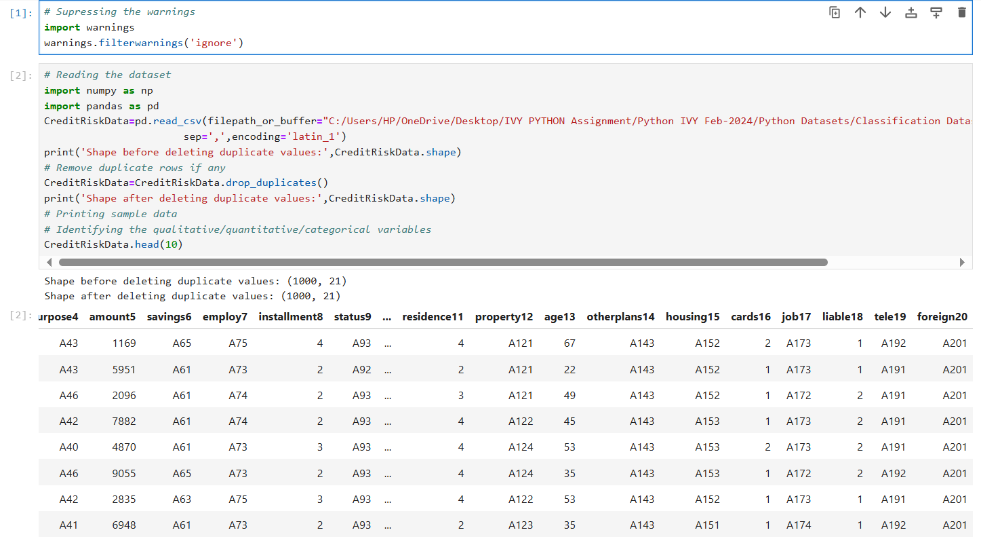
Data Loading And Initial Cleaning
The code suppresses warning messages and reads the CreditRiskData dataset while checking for duplicate rows to ensure data integrity. It then displays the shape of the dataset before and after removing duplicates, followed by printing the first ten rows to begin examining the variables.

Slide 5
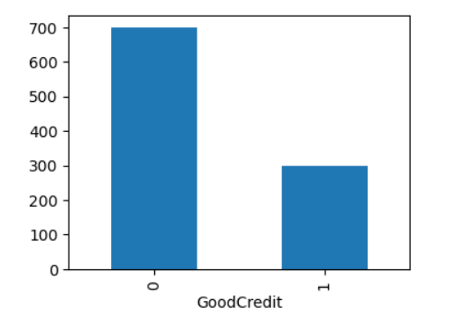
Analysis Of The Target Variable Distribution
The bar chart illustrates the distribution of the target variable GoodCredit, showing a satisfactory balance between the "good" and "bad" credit categories. This indicates there are sufficient data points in each category to support effective model training.

Slide 6
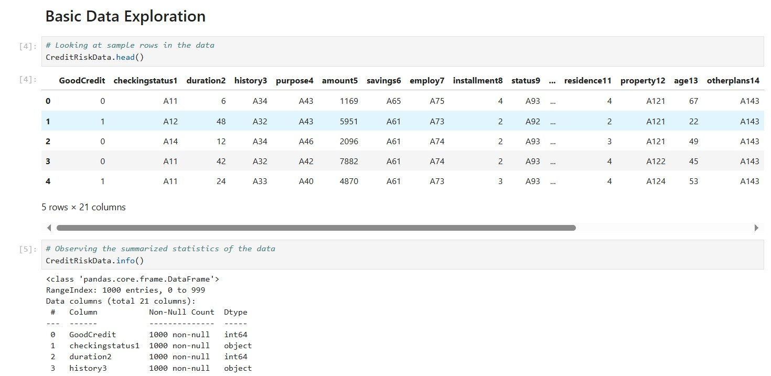
Foundations Of Data Exploration And Overview Of Dataset Structure
The initial exploration of the CreditRiskData involves using head() to examine sample rows for a quick overview of the dataset's structure. Then, info() provides essential details on data types, missing values, and memory usage, helping assess its overall quality for further analysis.

Slide 7
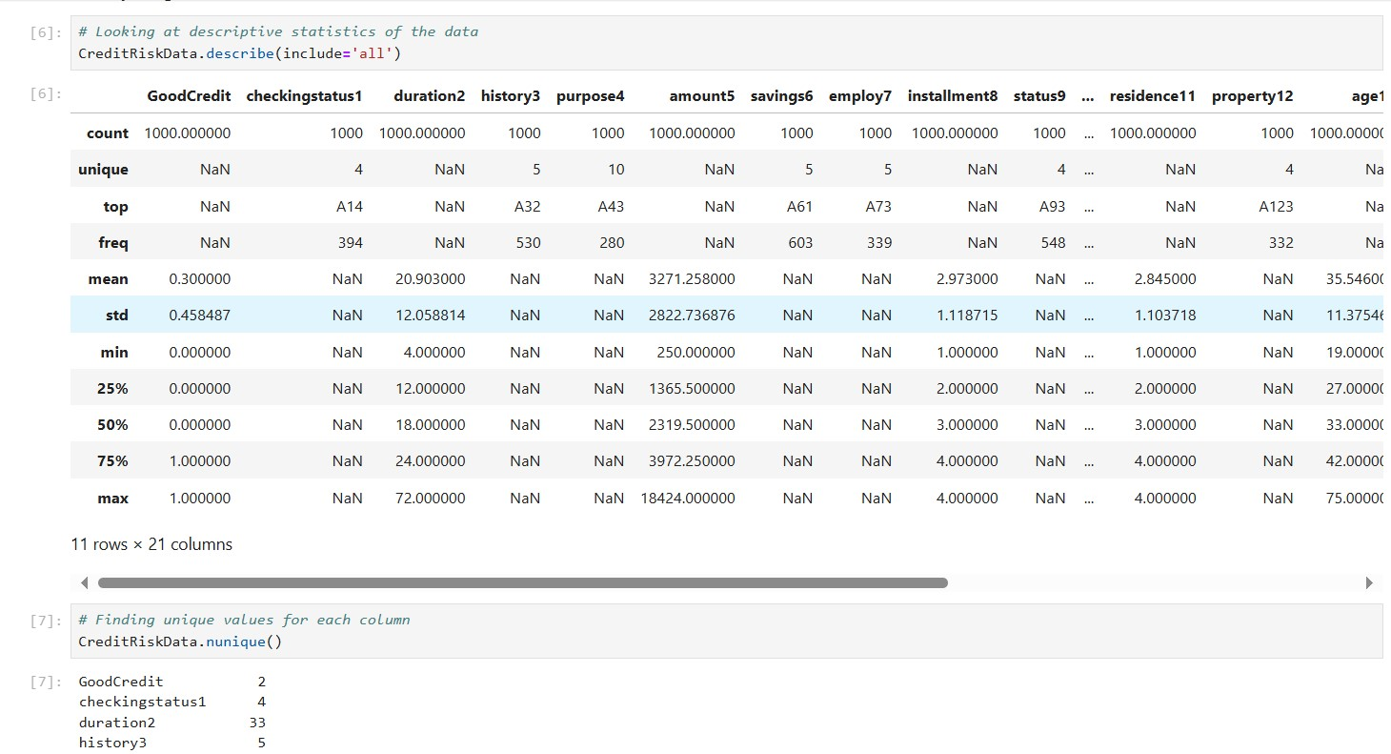
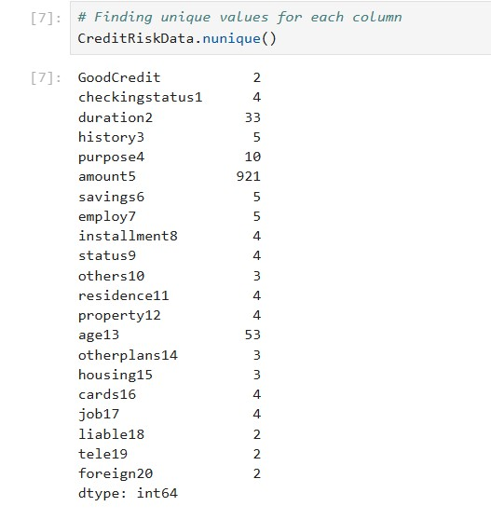
Descriptive Statistics Summary And Unique Value Analysis
The describe(include='all') function provides comprehensive descriptive statistics, summarizing key metrics like count, mean, and unique values for both numerical and categorical columns. Additionally, nunique() reveals the number of unique values in each column, offering insights into the data's variability and distribution.

Slide 8
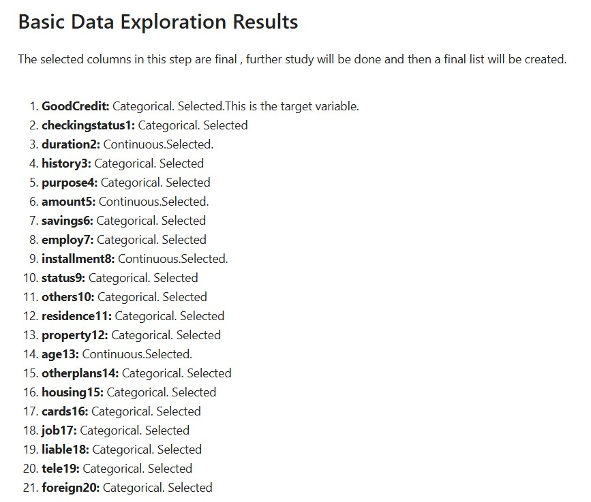
Initial Feature Selection and Roadmap
The basic data exploration identifies key columns for further analysis, categorizing them as either continuous or categorical variables. The target variable, GoodCredit, along with other selected features, will undergo additional study before finalizing the list for modeling.

Slide 9
Visualizing Categorical Variables In The Dataset
A custom function, is defined to create bar plots for multiple categorical predictors at once, visualizing their frequency distribution. This method highlights the distribution of key variables such as 'checkingstatus1', 'history3', 'purpose4', and others, allowing for easy comparison across multiple categories.

Slide 10
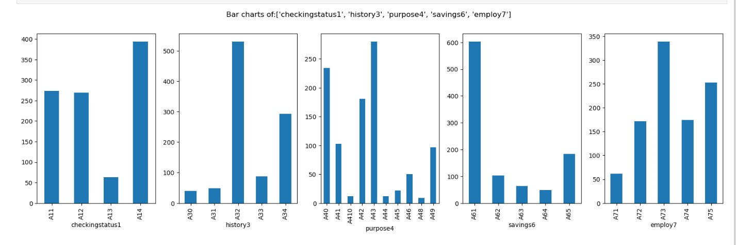
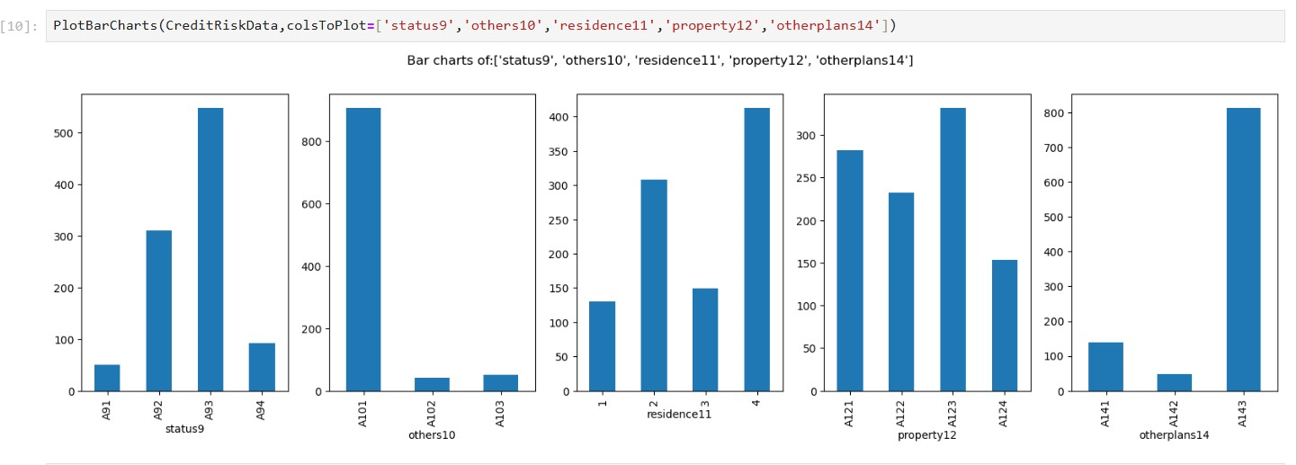
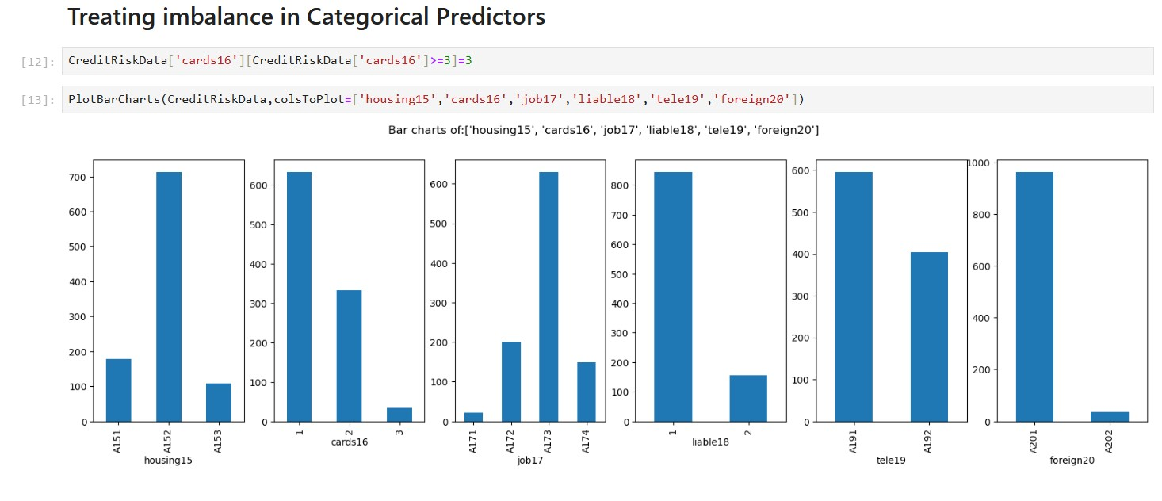
Bar Charts Interpretation
The bar chart analysis shows that all categorical variables have a well-distributed range of values, making them suitable for further analysis. Key predictors like 'checkingstatus1', 'history3', and 'purpose4' exhibit diverse frequency distributions, which will enhance the model's ability to identify patterns.

Slide 11
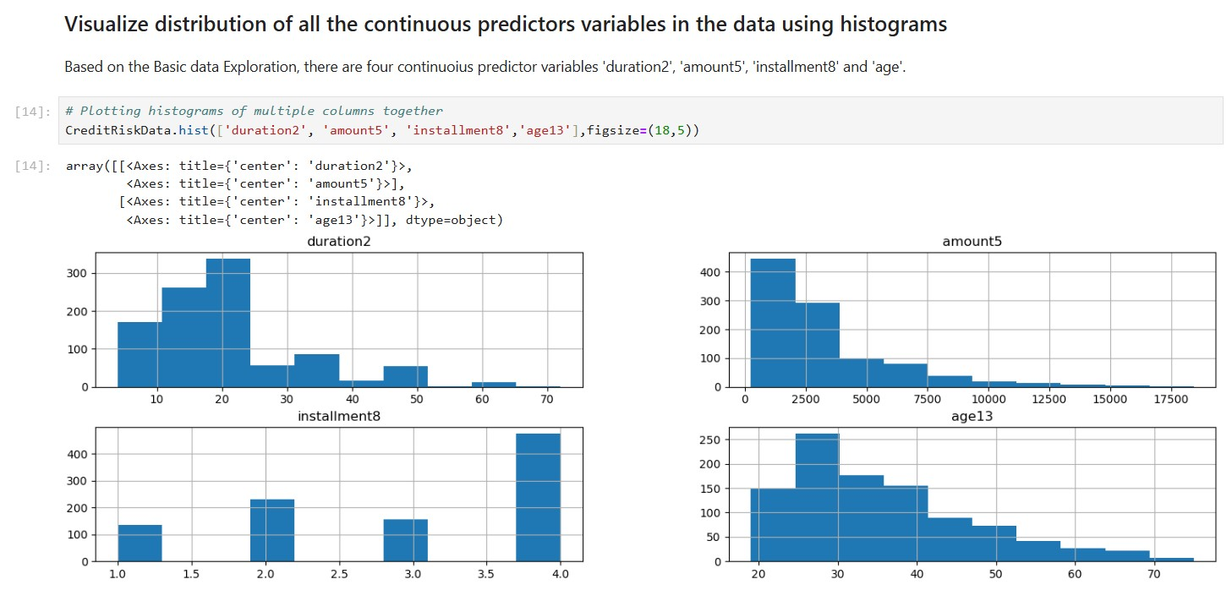
Histogram Interpretation
The histogram analysis reveals that duration2 and amount5 contain outliers beyond 70 and 17,500, respectively, requiring treatment before further analysis. In contrast, installment8 and age13 show well-distributed values, making them suitable for modeling without additional adjustments.

Slide 12
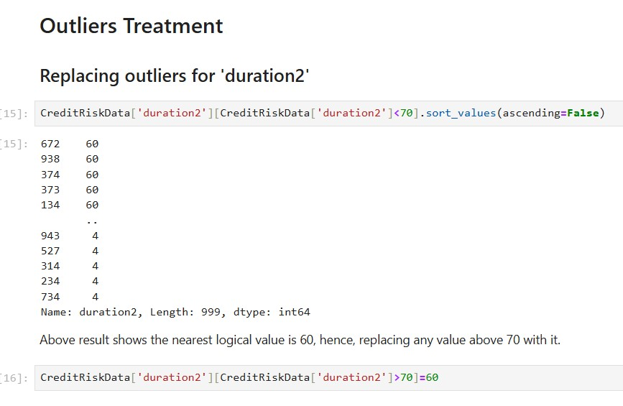
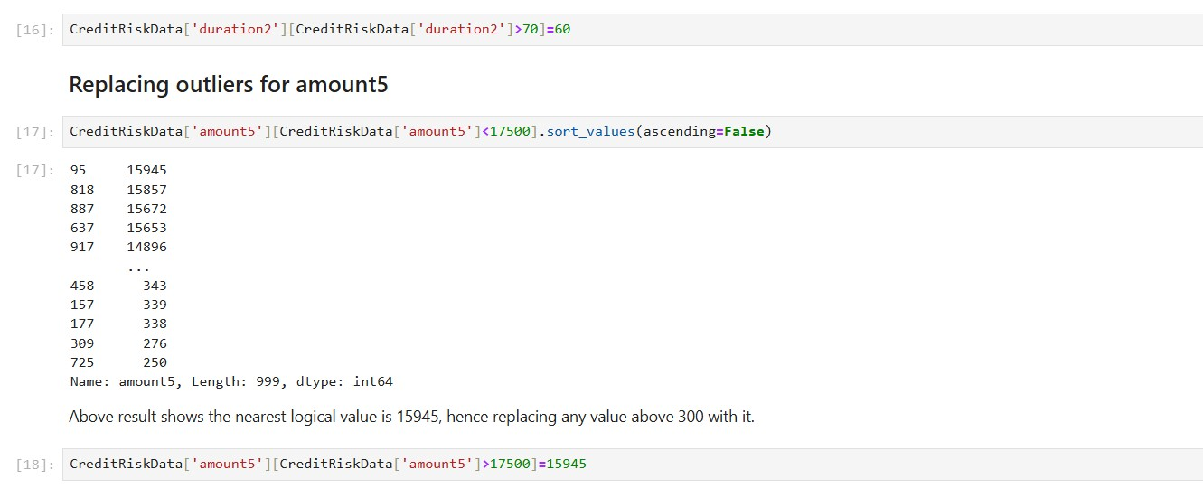
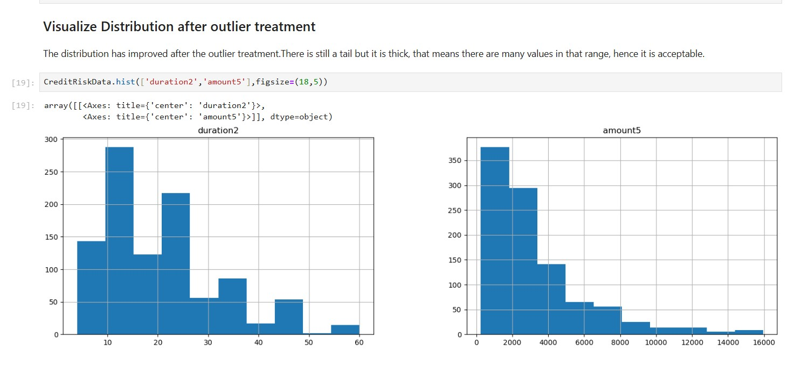
Outlier Detection and Treatment
Outliers in the duration2 variable are replaced with the nearest logical value of 60 for values above 70, while amount5 outliers are substituted with 15,945 for values exceeding 17,500. Post-treatment analysis indicates an improved distribution, characterized by a thick tail that suggests a sufficient density of values, making the data suitable for further modeling.

Slide 13
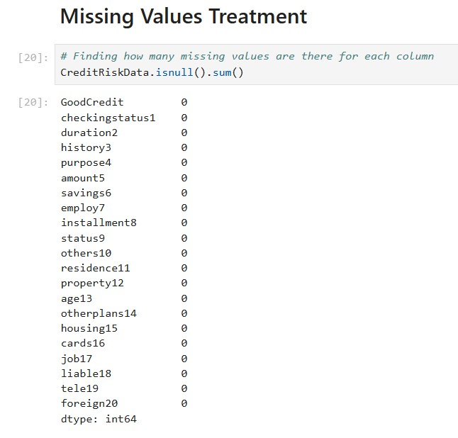
Missing Values Treatment and Imputation
The analysis of missing values reveals that all columns in the CreditRiskData dataset are complete, with no missing entries present. This ensures the integrity of the dataset for subsequent analysis and modeling efforts.

Slide 14
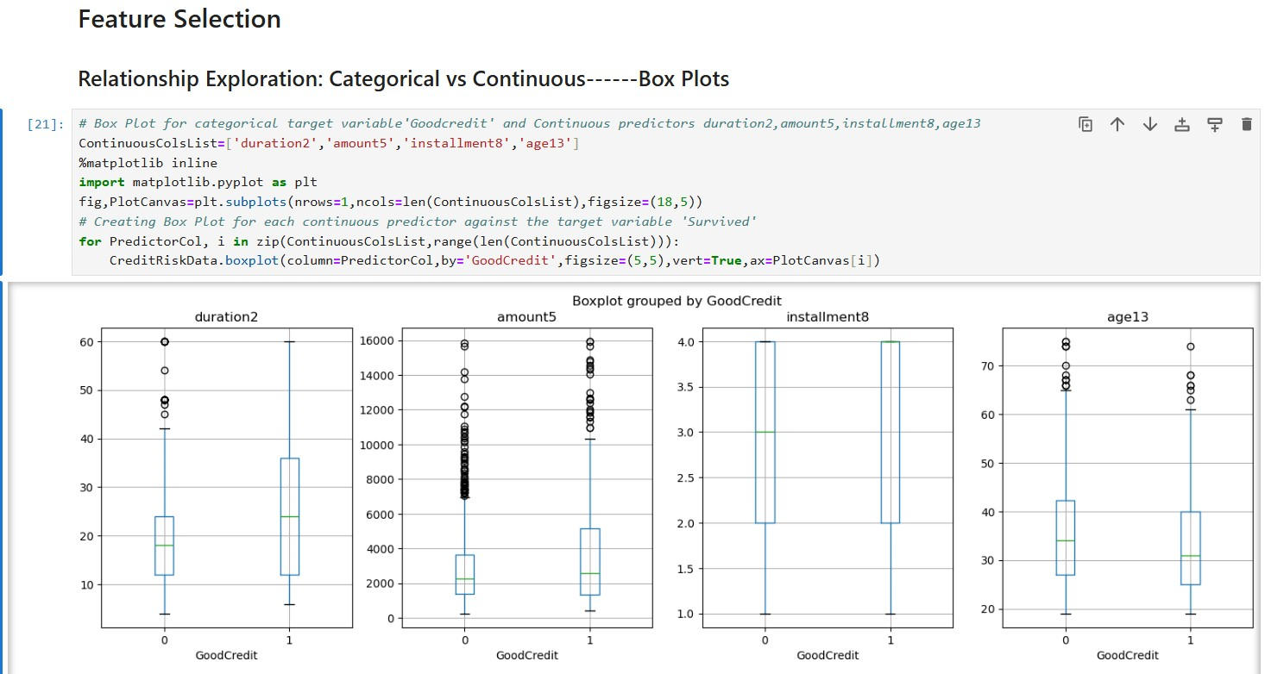
Box Plot Interpretation and ANOVA Analysis
Box plots were generated to explore the relationship between the categorical target variable GoodCredit and continuous predictors such as duration2, amount5, installment8, and age13. This visual analysis, complemented by the upcoming ANOVA test, will help confirm the significance of these relationships in predicting credit outcomes.

Slide 15
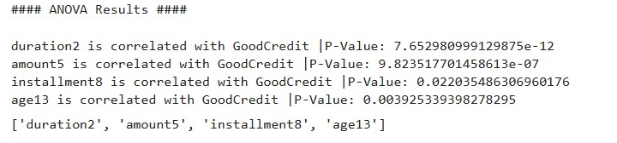
Statistical Feature Selection: ANOVA Test for Categorical Variables
The ANOVA test results indicate that all continuous predictors—duration2, amount5, installment8, and age13—are significantly correlated with the categorical target variable GoodCredit, as evidenced by their p-values falling below the 0.05 threshold. This statistical validation supports the inclusion of these features in the subsequent modeling process.

Slide 16
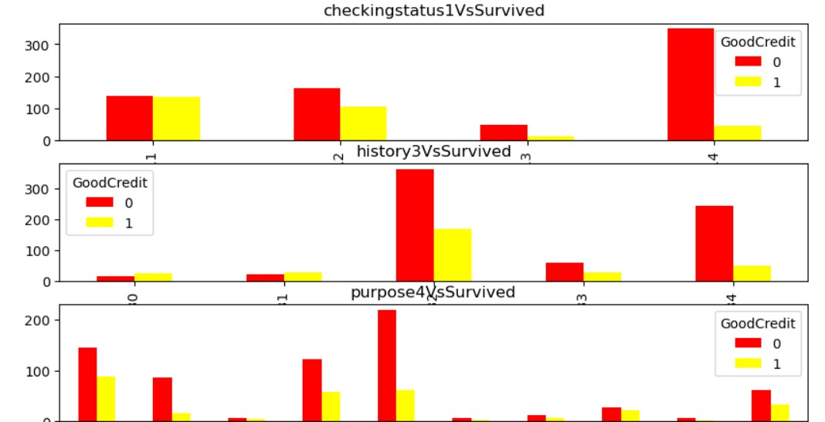
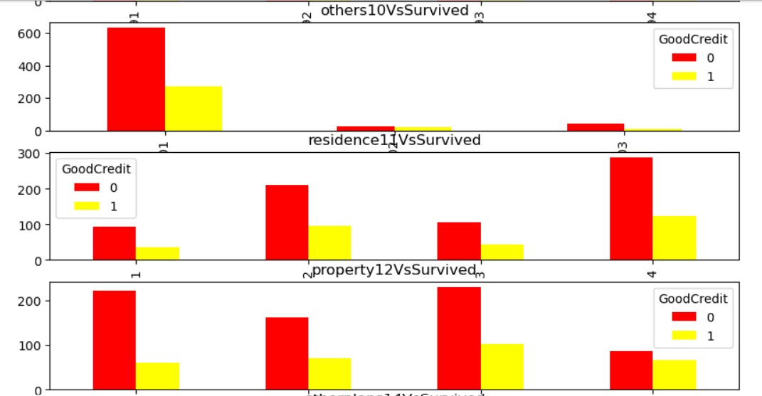
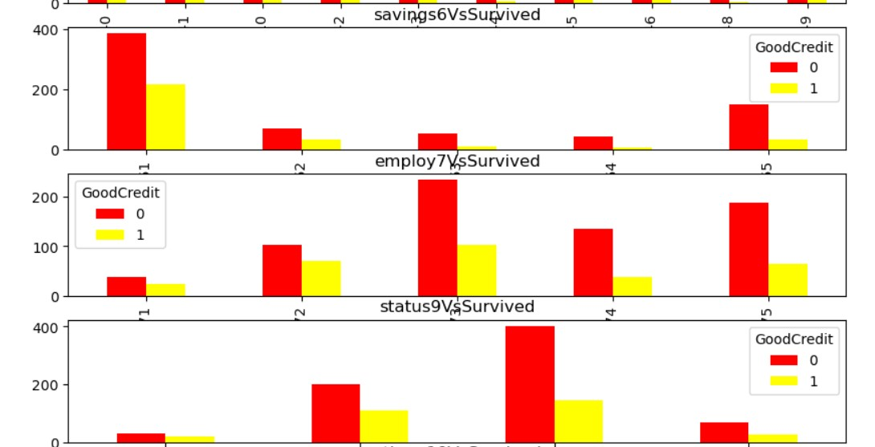
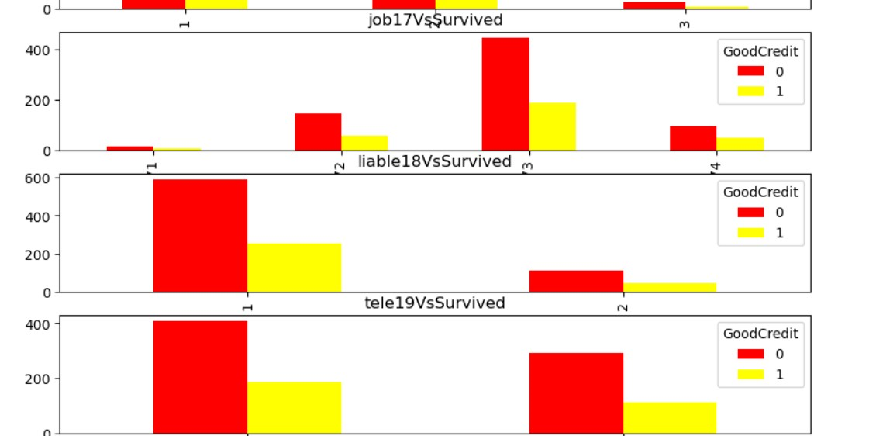
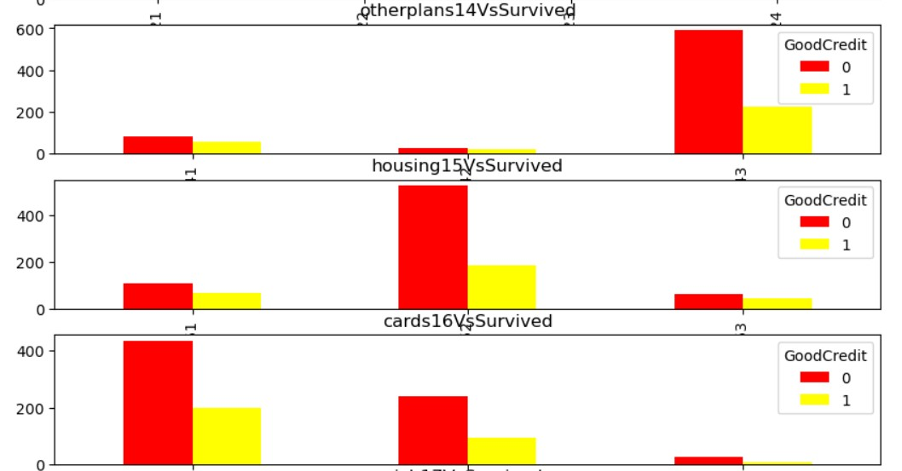
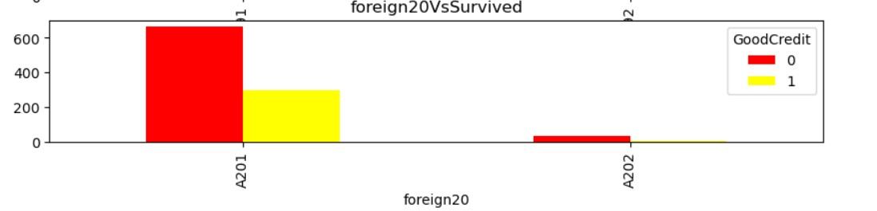
Grouped Bar Plots Interpretation and Chi-Square Test Analysis
The grouped bar charts display the frequency distribution of categorical predictors against the target variable GoodCredit, with the y-axis representing frequency and the x-axis representing categories. A consistent ratio of bars across categories suggests a lack of correlation, which will be further validated through Chi-Square Tests in the subsequent analysis.

Slide 17
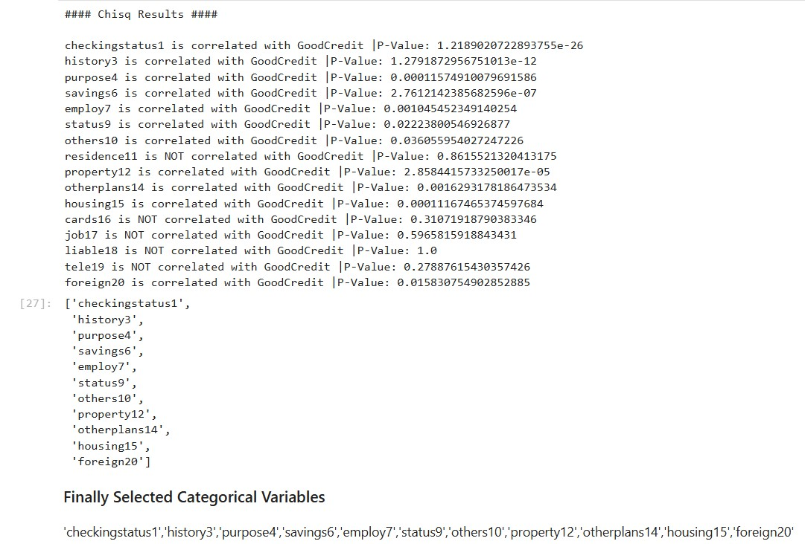
Statistical Feature Selection: Chi-Square Test Analysis
The Chi-Square test results indicate significant correlations between multiple categorical variables and the target variable GoodCredit, as evidenced by p-values below 0.05. The final selection of correlated categorical variables includes checkingstatus1, history3, purpose4, savings6, employ7, status9, others10, property12, otherplans14, housing15, and foreign20.

Slide 18
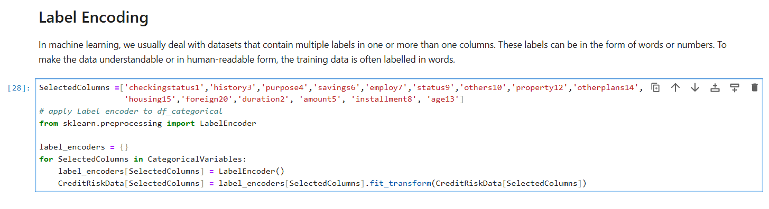
Label Encoding for Categorical Feature Transformation
Label encoding has been applied to the selected categorical columns, transforming text labels into numeric values to make the data suitable for machine learning algorithms. This step ensures that categorical data is now in a format understandable by the model while preserving the relationship between categories.

Slide 19
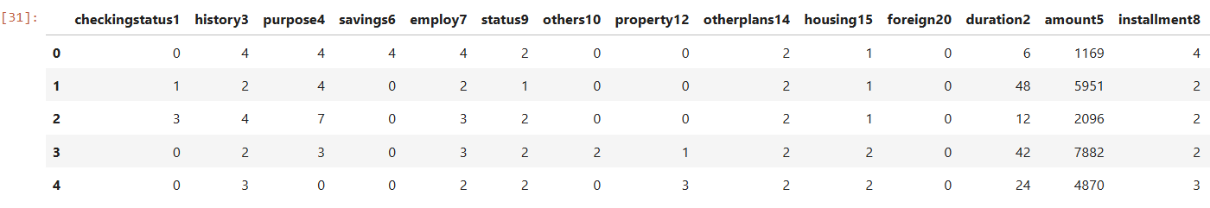
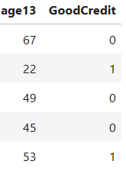
Final Dataset Preparation for Machine Learning Model
The dataset with the selected final predictors, including the target variable 'GoodCredit', has been prepared for machine learning analysis and saved for future use in a serialized format using the to_pickle method.

Slide 20
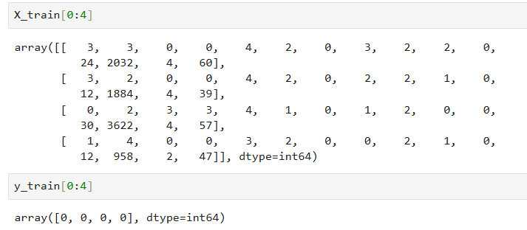
Data Splitting: Training vs Testing Set for Model Evaluation
The dataset is split into training and testing sets, where 70% is used for training the model, and 30% is reserved for testing its performance. The predictors are separated from the target variable, and the data is randomly split, ensuring fair model evaluation.

Slide 21
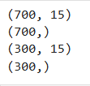
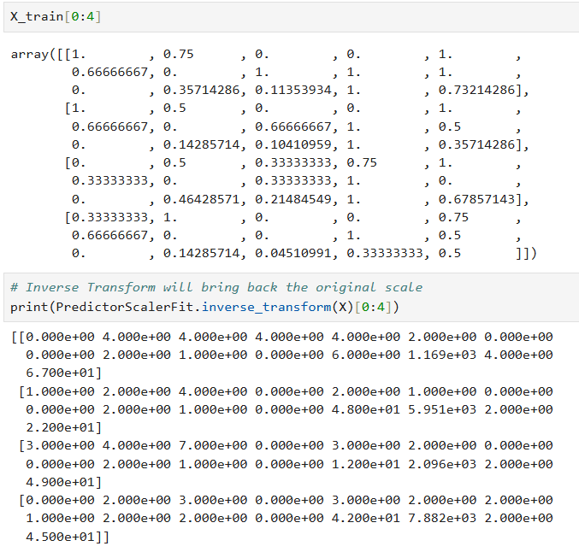
Data Standardization and Train-Test Split for Model Preparation
The data has been standardized using MinMaxScaler, which scales the values between 0 and 1, ensuring that each feature contributes equally to the model. After splitting the data into training and testing sets, the inverse transform demonstrates how the original values can be recovered from the scaled data.

Slide 22
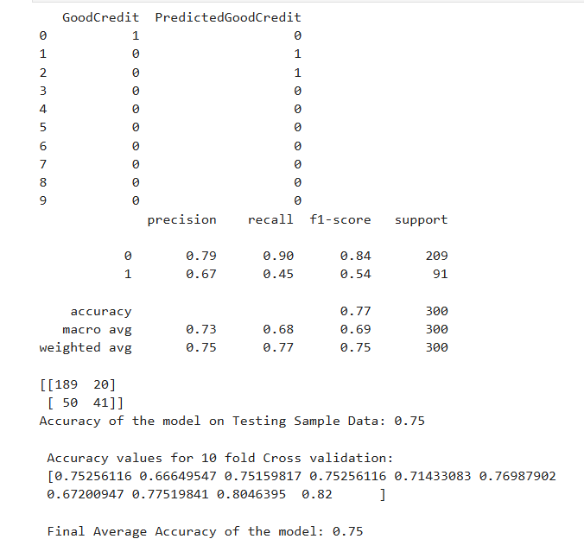
Logistic Regression Analysis: Performance Metrics and Results
The logistic regression model's predictions revealed a 75% overall accuracy on the test data, with precision and recall metrics highlighting its strengths in classifying good credit risk. The confusion matrix further illustrated the model's performance, achieving an average accuracy of 75% through 10-fold cross-validation, reinforcing its reliability in credit assessment.

Slide 23
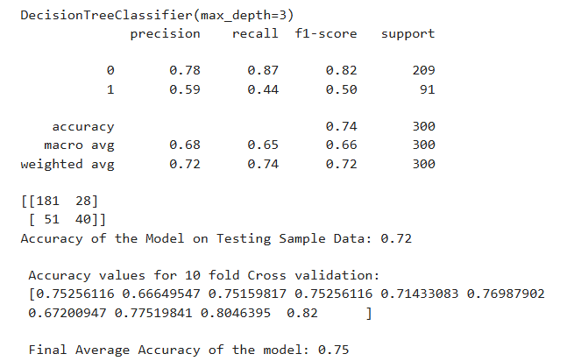
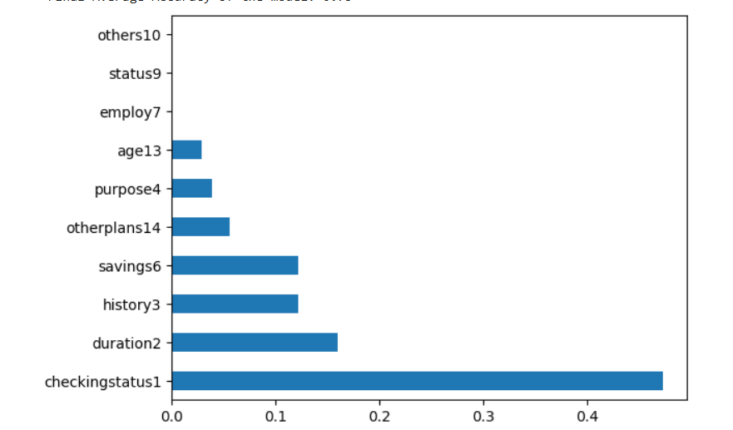
Decision Tree Model Performance Analysis
The Decision Tree model demonstrated a testing accuracy of 72%, with a precision of 78% for non-default credits and 59% for defaults, indicating a moderate ability to differentiate between the two classes. Additionally, 10-fold cross-validation yielded an average accuracy of 75%, affirming the model's robustness in predicting credit risk across various data splits.

Slide 24
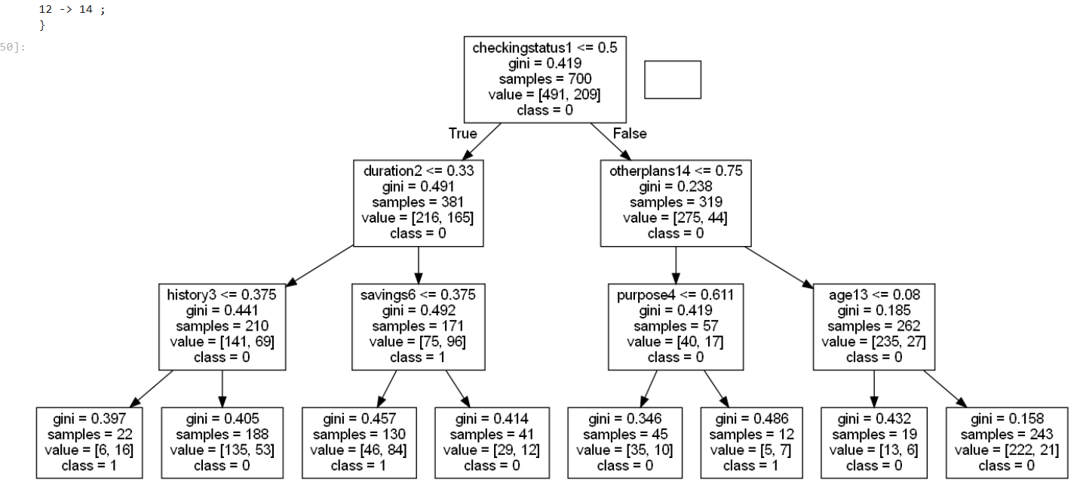
Visualizing the Decision Tree
The decision tree model is visualized using Graphviz, allowing for a clear representation of the classification rules derived from the data. This graphical depiction enhances interpretability, showcasing the decision-making process of the model in predicting credit risk based on the selected features.

Slide 25
THANK YOU

